Slide 1
“What Can I Do with an Advanced Degree in Literature?”
A presentation for the FSU English AdLit. group
April 28, 2017

Slide 2
“What Can I Do with an Advanced Degree in Literature?”
In many respects, the above question is better phrased as “What CAN’T I do with an advanced degree in literature?”
An advanced degree in lit. prepares candidates for jobs in many fields.
The degree alone will qualify graduates for a number of jobs, particularly in “alt-ac” and SOTL fields.
But getting a job in any field is always based on more than a degree alone.

Slide 3
The Value of a Lit. Degree
Critical thinking
Careful, close reading
Attention to detail
Global perspective
Empathy
Data analysis
Skepticism regarding easy answers or conclusions
Reluctance to make rash judgments
Ability to observe trends over time and consider multiple possible outcomes
Ability to learn new skills and to do so thoroughly
Writing and editing
Project management
Multi-tasking and time management
What else?

Slide 4
Job areas
Alt-ac – higher ed. administration – many categories within this large field
https://chroniclevitae.com/
State government
State agencies - https://jobs.myflorida.com/
Legislature - http://www.leg.state.fl.us/
Federal government
https://www.usajobs.gov/

Slide 5
Job areas
Secondary (K-12) education
Public school systems
Private schools
Nonprofits
https://www.idealist.org
Policy research/policy analysis
Government
Nonprofits/think tanks

Slide 6
Job areas
Marketing/marketing research
Grant writing
Business/entrepreneurship
Tech
And much more –
Versatile PhD: http://gradschool.fsu.edu/professional-development/versatile-phd
The Professor Is in: http://theprofessorisin.com/

Slide 7
Prepare yourself
Avail yourself of resources
The Graduate School - http://gradschool.fsu.edu/
Career Center – http://www.career.fsu.edu/students/graduate-students
Translate your skills and learn the lexicons of interesting fields
Conduct informational interviews, “shadow” or do site visits
Connect on LinkedIn
Practice – writing and speaking the language

Slide 8
Prepare yourself
Get a certificate, another degree, or take some courses
Start a business, freelance, and/or volunteer
Research and write about fields of interest – have tangible products to demonstrate genuine interest and investment
Connect with people in those areas – build your network, let people know you’re looking (speak up – don’t wait for people to tell you about opportunities)

Slide 9
Prepare yourself
An advanced degree may get you in the door, but it won’t get you the job
Avoid common pitfalls during the hiring process (and when you get the job):
Entitlement
Obviously “settling” and temporary
Expecting too much too early – salary, power, responsibility
Assuming there’s nothing new to learn
Treating the work as less important or meaningful than academic work

Slide 10
Prepare yourself
Hiring processes and timelines in most other fields are slightly less crazy than those in academia.
Learn through experience.
You won’t get all the jobs you are obviously qualified for, and that’s OK.
Be open to finding meaningful work in unexpected places.
Be patient – allow time.

Slide 11
Prepare yourself
The first job you get probably won’t be the last one.
Look at each experience as an opportunity to learn – about the job, the field, and yourself.
Envision yourself finding meaningful careers in a range of possible fields – what does that look like?
Know yourself – imagine your future self. Is a career an end in itself or a means to an end? What are your goals? What kind of career will enable you to meet those goals?

Slide 12
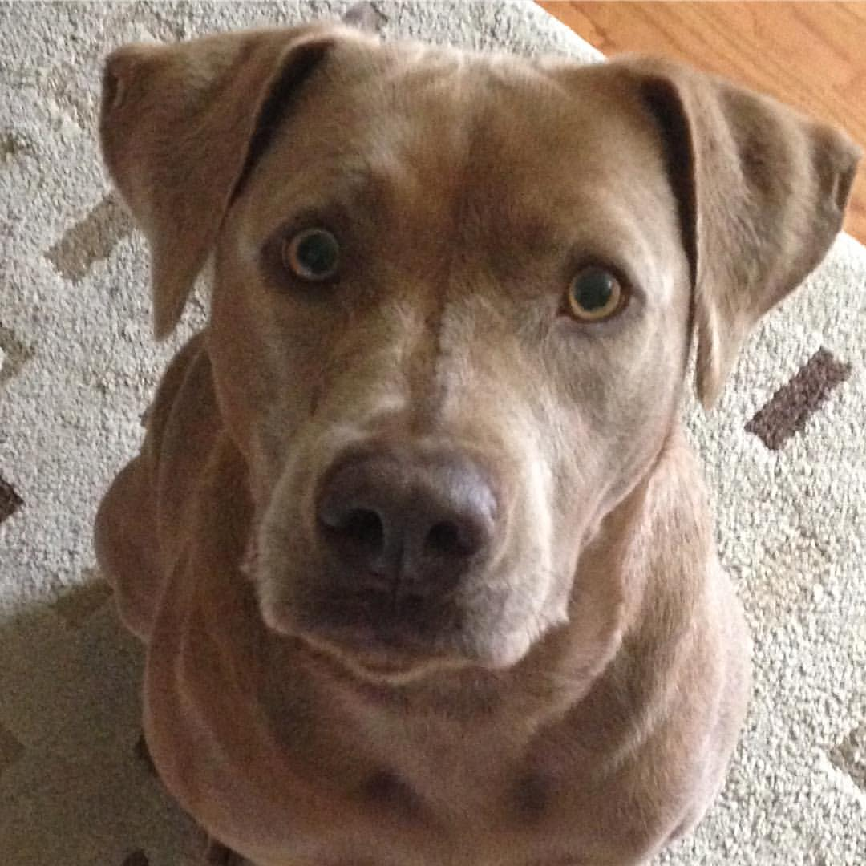
Questions?
Beatrice wishes you all success in achieving your career goals!

